Slide 1


WRITE A TITLE IN THIS SECTION
Final project
年终报告
Final Presentation
By faith I mean a vision of good one cherishes and the enthusiasm
that pushes one to seek its fulfillment regardless of obstacles.
设计师：梦想PPT 部门：营销部
Group 5
BI XIAOYANG
WANG QIPENG
ZHANG YICHI
HU YAQI
AIT2009357(Leader) AIT2009376(Presenter)AIT2009380
AIT2009364

Slide 2

Abstract
Under the COVID-19 situation, in order to keep people companioned and make contribution to the struggle against the epidemic, our group decided to build a chatbot based on seq2seq model whose Q&A system can generate responses to not only daily dialogues, but also questions about preventive measures against COVID-19 and about vaccination.

Slide 3
a
Introduction
Bring together the basic concepts of the underlying principles
TABLE OF
Literature Survey/ Review on the existing applications.
search for seq2seq chatbot’s academic development
b
c
Methodology of the project
display 2 improved algorithms we found for Seq2seq chatbot
CONTENTS
d
Intelligent system design
Existing chatbot that has similar functions as our purpose

Slide 4
e
Discussion
Bring together the basic concepts of the underlying principles
TABLE OF
f
Conclusion
search for seq2seq chatbot’s academic development
g
References
display 2 improved algorithms we found for Seq2seq chatbot
CONTENTS

Slide 5
01
Part I

Slide 6
Introduction
Sequence to sequence model is a variant of Recurrent Neural Network that consists of Encoder and Decoder components. Seq2Seq is an important model in natural language processing and can be used in machine language translation, text summarization, and chatbot. In our project, we will apply it to building a chatbot.

Slide 7
Introduction
Being under the Covid-19 situation is a tough time, and hopefully we may apply Recurrent Neural Network to build a Seq2seq chatbot, whose Q&A system can generate responses to not only daily dialogues, but also your questions about preventive measures against COVID-19 and about vaccination.
Based on our research, we want this Seq2seq Chatbot can be used on a large scale in countries where there is a lack of awareness of the COVID-19.

Slide 8
02
Part II

Slide 9
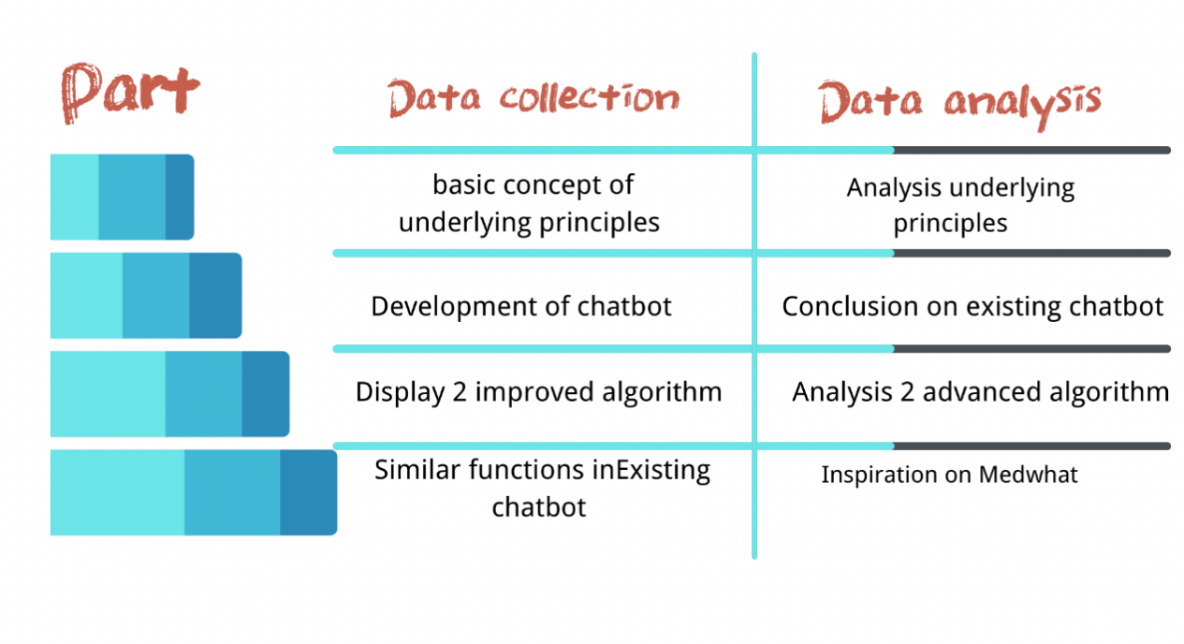
Literature Survey/ Review on the existing applications.
Being under the Covid-19 situation is a tough time, and hopefully we may apply Recurrent Neural Network to build a Seq2seq chatbot, whose Q&A system can generate responses to not only daily dialogues, but also your questions about preventive measures against COVID-19 and about vaccination.
Based on our research, we want this Seq2seq Chatbot can be used on a large scale in countries where there is a lack of awareness of the COVID-19.

Slide 10
03
Part III

Slide 11
Methodology of the project
During the Data collection and analysis phase, we set out to learn about different types of chatbots, the chatbot is trained to use training data in the form of customer service talks with customers in several business fields. In this section, we will elaborate on our project preparation and coding process.

Slide 12
i. Research Approach
As Python was chosen to be our programming language, the SequenceToSequence (Seq2Seq), is one of our basic methods to realize our goal.
The training data is then used to build learning models in both the Simple RNN algorithm and the LSTM algorithm.

Slide 13
ii. Research Process
Dataset
The corpus uses electronic computers as the carrier to carry the basic resources of language knowledge, but it is not equal to language knowledge. Real corpus needs to be processed (analyzed and processed) before it can become a useful resource.

Slide 14
ii. Research Process
Dataset
The cleaning of the corpus is also very important. It directly determines the effect of the model, and even affects the convergence of the model, unanswered questions, grammatical errors, etc. .

Slide 15
ii. Research Process
Dataset
The format of storage is the first behavior question, the second behavior answer, the third row is the question, and the fourth behavior answer. And so on. Considering the quantity and quality of corpus, we choose two corpus.

Slide 16
ii. Research Process
Dataset
The format of storage is the first behavior question, the second behavior answer, the third row is the question, and the fourth behavior answer. And so on. Considering the quantity and quality of corpus, we choose two corpus.

Slide 17
ii. Research Process
Dataset
The first one is a corpus consists of Movie lines from 50 European and American films used in the daily conversation.The second corpus is 200 long article about the knowledge and precautions of COVID-19 on Twitter.

Slide 18
ii. Research Process
Encoding
1. Config.py parameter #configuration file
The configuration of model super parameters and related file path is mainly carried out.
2. Dataprocessing.py #preprocessing files
Mainly processing the corpus, including corpus processing, encoding index, generation of the word vector file EMB of the corpus, etc.

Slide 19
ii. Research Process
Encoding
3. Read vecor.py #to modify the word vector file
The original word vector is trained by the Wikipedia corpus word2vec. Now we need to modify the original word vector to some extent.
4.SequenceToSequence. Py #Seq2Seq model
Defines model encoder, decoder, optimizer, training, prediction

Slide 20
ii. Research Process
Encoding
5.Train. Py #training file
The operation simply needs to run this file.
6.RestfulAPI.py
Run this file, and then open index.html to start the man-machine conversation.

Slide 21
04
Part IV

Slide 22
Description of the system/application.
We finally sum up our thoughts on how we make our Seq2seq Chatbot into applications and find the direction of what will we research in the next step.And also we have given him the name after a group discussion, named “Medi-Assistant”.

Slide 23
Description of the system/application.
Medi-Assistant will use a technique called deep learning and its model based on a recurrent neural network (RNN) . An RNN has a problem of vanishing-gradient so that our designed Seq2Seq models use an advanced RNN called long short-term memory (LSTM).

Slide 24
Description of the system/application.
For the domain of our designed Seq2Seq chatbot, we think it will be a Q&A system about daily conversation and the knowledge of preventive measures against Covid-19.

Slide 25
Description of the system/application.
The application of Medi-Assistant can be applied mainly in many developing country where is the population there is not aware of the Covid-19. What’s more, it can also been used in the cross-platform centralized messaging.

Slide 26
Description of the system/application.
Being under the Covid-19 situation is a tough time, and hopefully we may apply Recurrent Neural Network to build a Seq2seq chatbot, whose Q&A system can generate responses to not only daily dialogues, but also your questions about preventive measures against COVID-19 and about vaccination.

Slide 27
Conceptual design of the system/application
Through the collection and analysis of existing data and information and looked at a number of papers published in academic journals on the subject and investigated some of the chatbot applications that have been recognised by professionals in the last two years, we have gained new insights into Seq2Seq Chatbot .

Slide 28
Conceptual design of the system/application
1.Seq2Seq chatbot not only can be used in Q&A system
2.The chatbot has a very promising future under COVID-19 situation
3.The problem for template-based chatbot is it is time consuming and takes a lot of effort to write the rules manually.

Slide 29
Conceptual design of the system/application
First we found 20 blogs in the Internet about the COVID-19 as our dataset. Then we used tensorflow and RNN to generate a trainable train.py, then we used a series of training to generate a Seq2Seq model, then we used natural language processing and tensorflow to create a chatbot, and finally we used HTML to create a user interface. In the making process, we need to test it and measure its accuracy and loss.

Slide 30
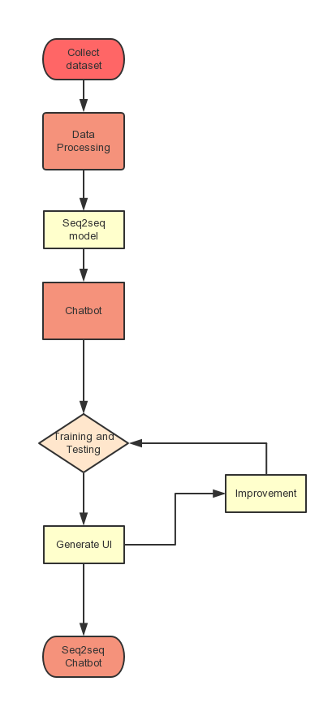
Flow chart of specific production steps
In the beginning of doing this project, We work in data collection and analysis. After we processing the data, we start to do Seq2Seq Chatbot. First, we build a Seq2Seq model and based on it, we make a chatbot. Then we train and test it, make improvements based on the errors. Finally, we generate an UI to show the functions of chatbot for user.

Slide 31
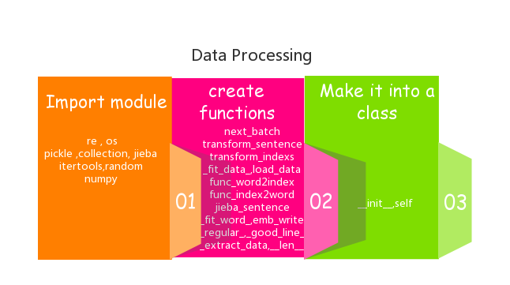
Flow chart of specific production steps
In the data processing we create a file call DataProcessing.py
First step to make it is importing module, and then it will have create functions.Then finally, it will be made into a class because it will be used in the main.py.

Slide 32
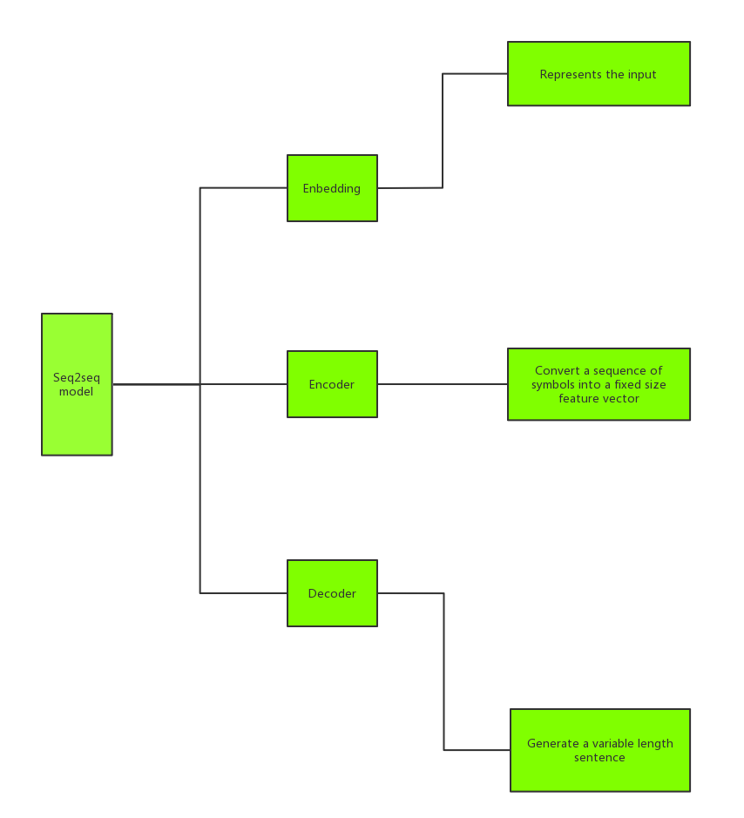
Flow chart of specific production steps
We all know the Seq2Seq model have three parts: Enbedding, Encoder, Decoder. And what we need in the making Seq2Seq model?

Slide 33
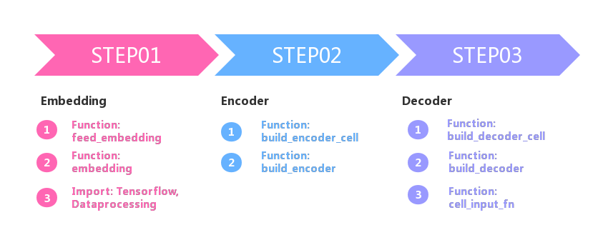
Flow chart of specific production steps
In making Enbedding, we need two functions and some important modules such as Tensorflow, DataProcessing. And then we start to build Encoder and Decoder, it is combined by several functions like Build_encoder_cell, Build_encoder_cell.

Slide 34
Flow chart of specific production steps
In making Enbedding, we need two functions and some important modules such as Tensorflow, DataProcessing. And then we start to build Encoder and Decoder, it is combined by several functions like Build_encoder_cell, Build_encoder_cell.

Slide 35
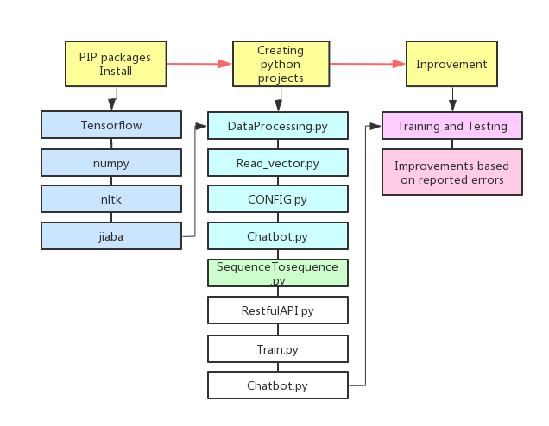
Flow chart of specific production steps
After we construct the Seq2Seq model, we need a chatbot to implement the chatting function. This chatbot is no different from a normal chatbot, We use a number of packages such as Tensorflow, numpy and nltk. And also we create a file to make it function, called Chatbot.py. After finishing it, we need to correct the errors it shows in python console and make improvements.

Slide 36
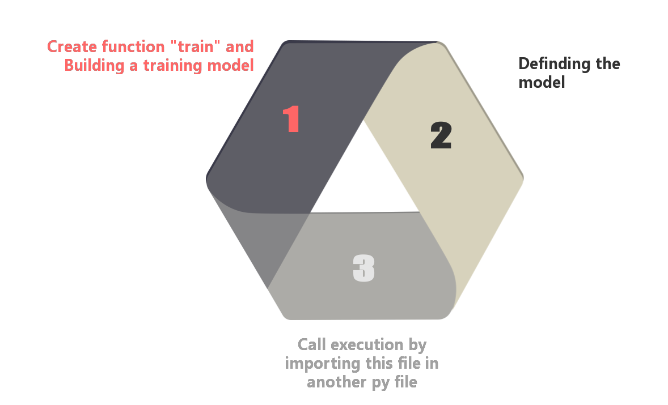
Flow chart of specific production steps
To train this Seq2Seq model, we need to build a file called Train.py and in this file, we define a training model that can train the chatbot. And also, it will be made into a class because it is used in Sequence2Sequence model.py file.

Slide 37
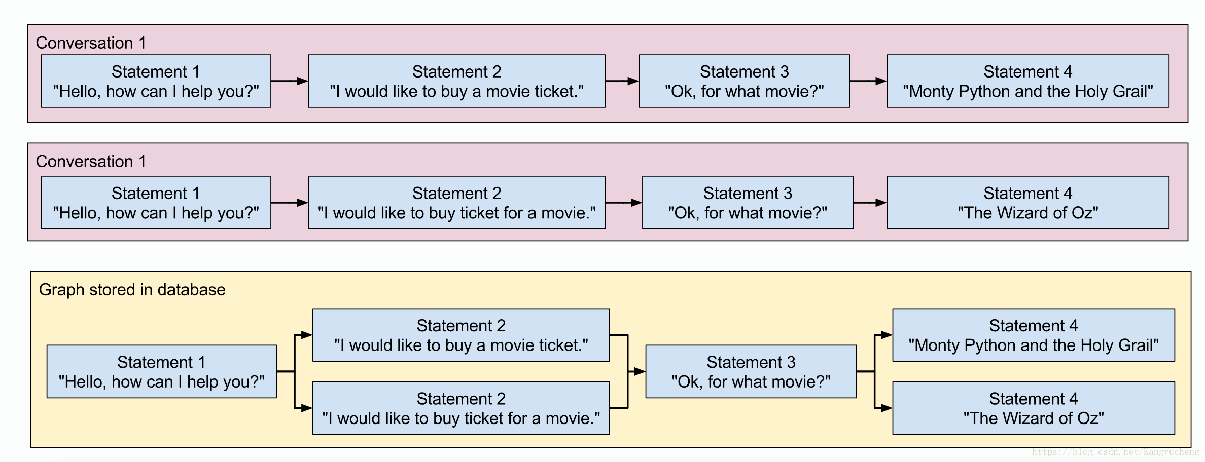
Flow chart of specific production steps
We test it by a series of conversation.The first asking sentence is “Hello, how can I help you?” .The chatbot will answer two different sentence since it train the corpus and the data have been stored in database. Similarily, when asking “OK, for what movies?”, it will randomly answer one of two different sentence stored in database.

Slide 38
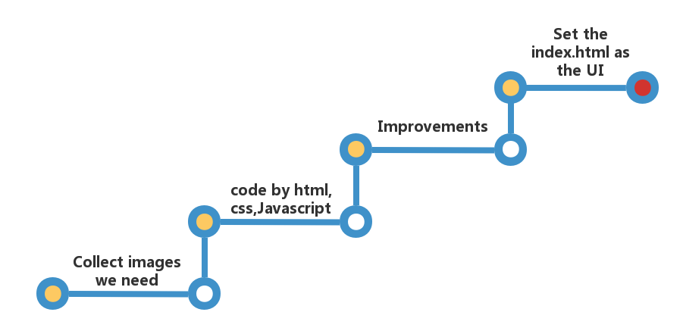
Flow chart of specific production steps
To make a user interface, we found a template and we imitate it. First we found some images and then start to code by HTML, CSS, Javascript. Also it still to make improvements when we repeatedly observed the UI presentation.

Slide 39
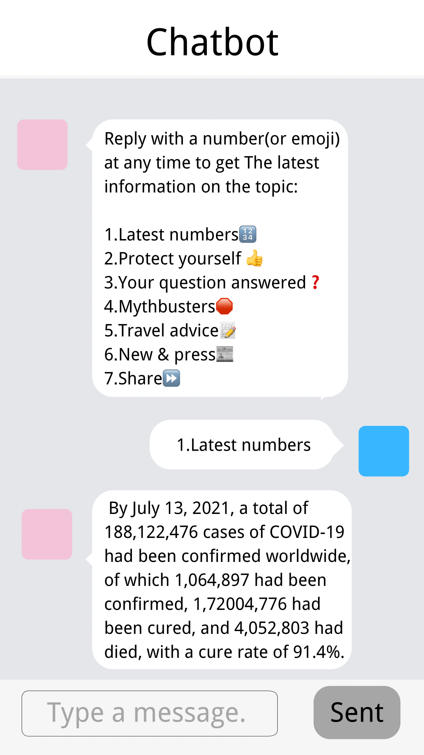
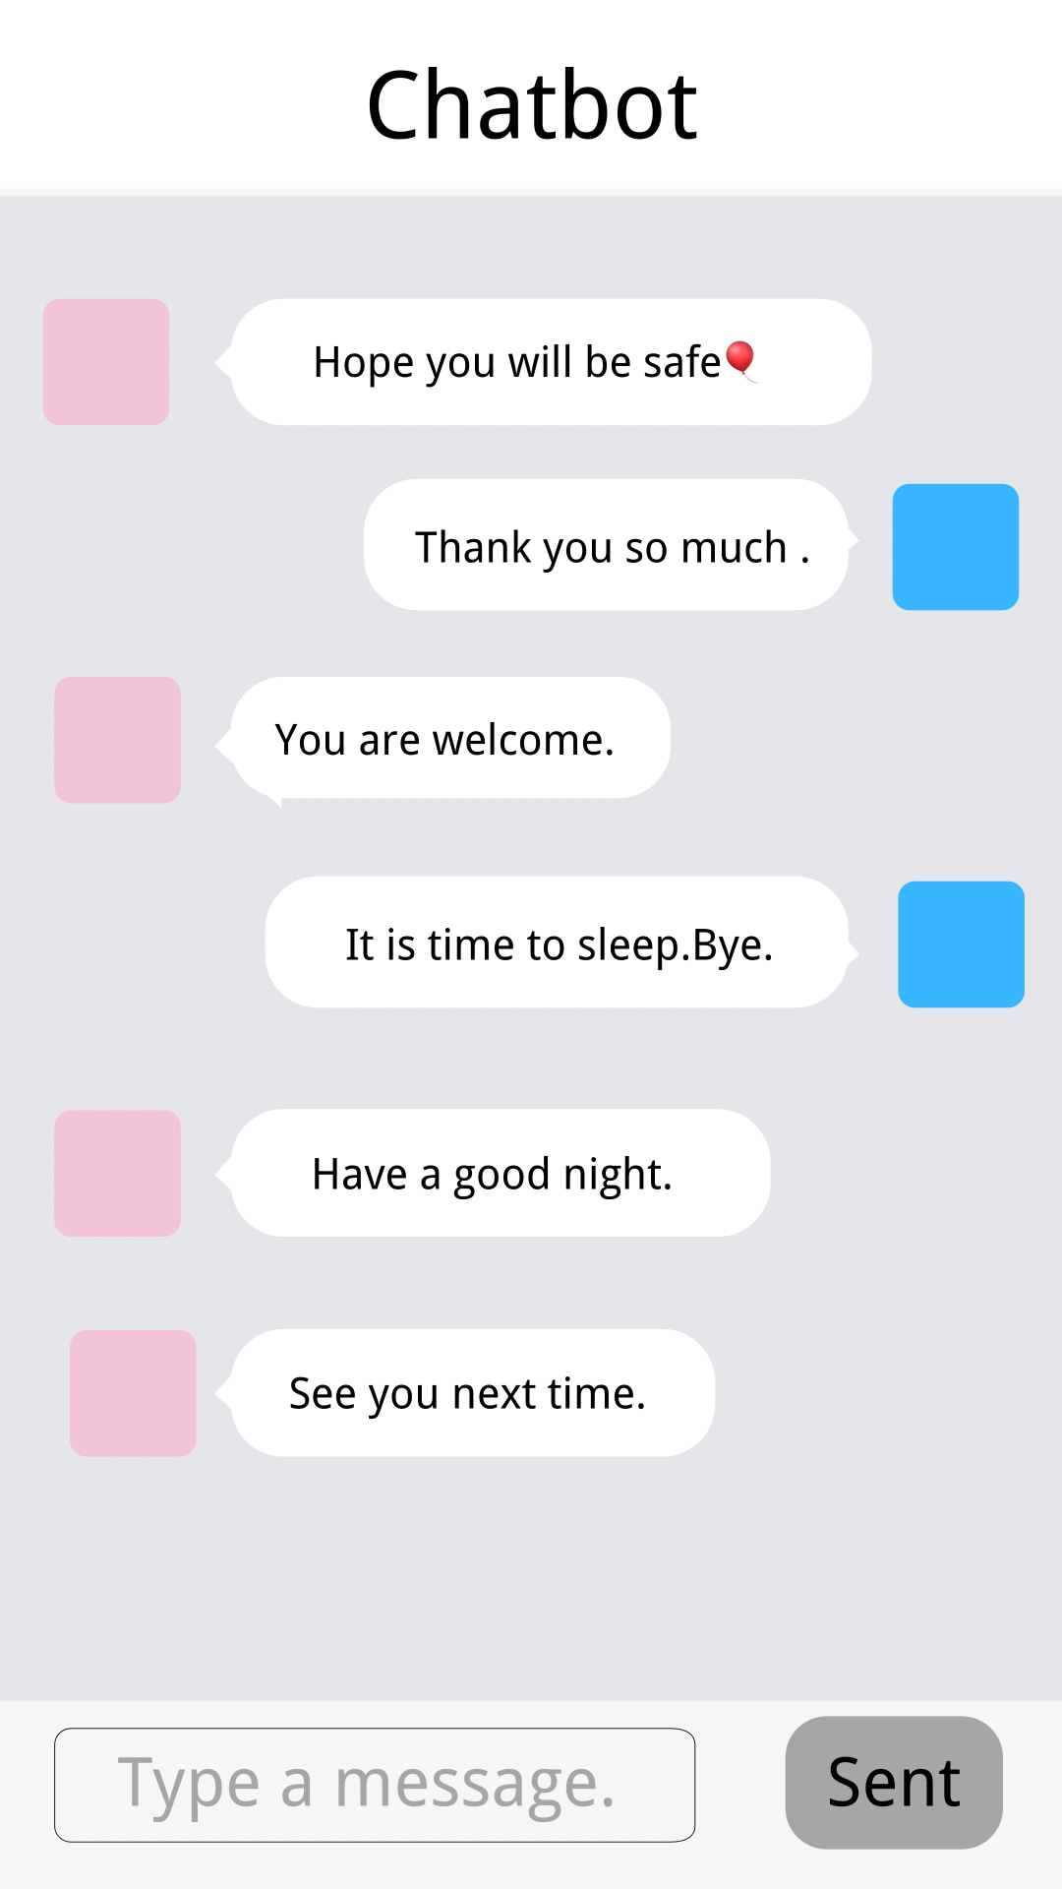
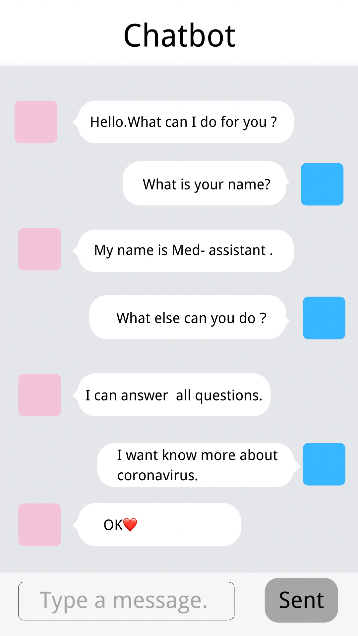

Slide 40
Source code
A

Slide 41
05
Part V

Slide 42
Discussion
A

Slide 43
06
Part VI

Slide 44
Conclusion
A

Slide 45
07
Part VII

Slide 46
References
1. Abonia Sojasingarayar, Seq2Seq AI Chatbot with Attention Mechanism (2020)
2. Jurgita Kapociute-Dzikiene, A Domain-Specific Generative Chatbot Trained from Little Data (2020)
3. Kulothunkan Palasundram, Nurfadhlina Mohd Sharef. Norul Amelina Nashruddin, Khairul Azhar Kasmiran, Azreen Azman, Sequence to Sequence Model Performance for Education Chatbot (2019)
4. Yulius Denny Prabowo, Harco Leslie Hendric Spits Warnarrs, Widodo Budiharto, Achmad Imam Kistijantoro, Yaya Heryadi, Lukas, Lstm And Simple Rnn Comparison In The Problem Of Sequence To Sequence On Conversation Data Using Bahasa Indonesia (2018)
5. Panitan Muangkammuen, Narong Intiruk, Kanda Runapongsa Saikaew, Automatic Thai-FAQ Chatbot using RNN-LSTM (2021)

Slide 47
References
6. Ankil Shah, Bhargav Jain, Bhavin Agrawal, Saurabh Jain, Simon Shim, Problem Solving Chatbot for Data Structures (2018)
7. Yogi Wisesa Chandraa , Suyanto Suyanto, Indonesian Chatbot of University Admission Using a Question Answering System Based on Sequence-to-Sequence Model (2019)
8. Dan Shewan, 10 of the Most Innovative Chatbots on the web(2021)
9.Dzmitry Bahdanau, Kyunghyun cho, Yoshua Bengio, Neural Machine Translation by Jointly Learning to Align and Translate9[Submitted on 1 Sep 2014 (v1), last revised 19 May 2016 (this version, v7)]
10.Kyunghyun cho, Bart van Merrienboer, Caglare Gulcehre, Dzmitry Bahdanau, Fethi bougares, Holger Schwenk, Yoshua Bengio, Learning parase representations using RNN Encoder-Decoder for Statiscal Machine Translation[Submitted on 3 Jun 2014 (v1), last revised 3 Sep 2014 (this version, v3)]

Slide 48
WRITE A TITLE IN THIS SECTION
年终报告
Thanks
By faith I mean a vision of good one cherishes and the enthusiasm
that pushes one to seek its fulfillment regardless of obstacles.
设计师：梦想PPT 部门：营销部
Take good care yourself and stay safe

